Slide 1
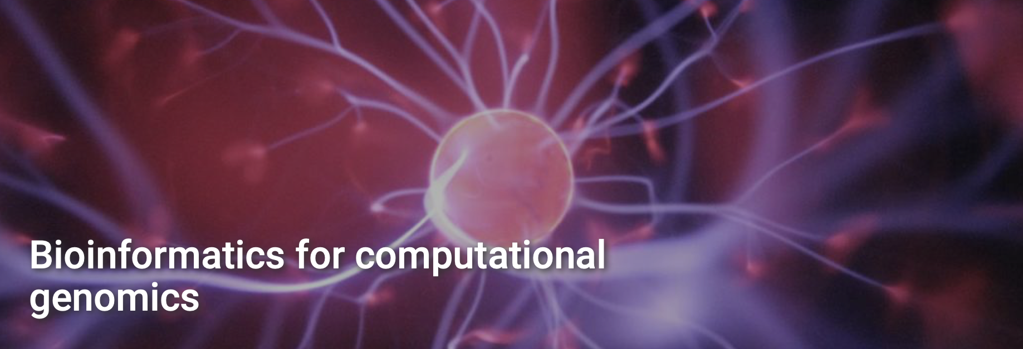
Process the ChIP-Seq data for an ENCODE experiment
Epigenomics
Leonardo Nossa
Leonardo.nossa@student.unimi.it

Slide 2
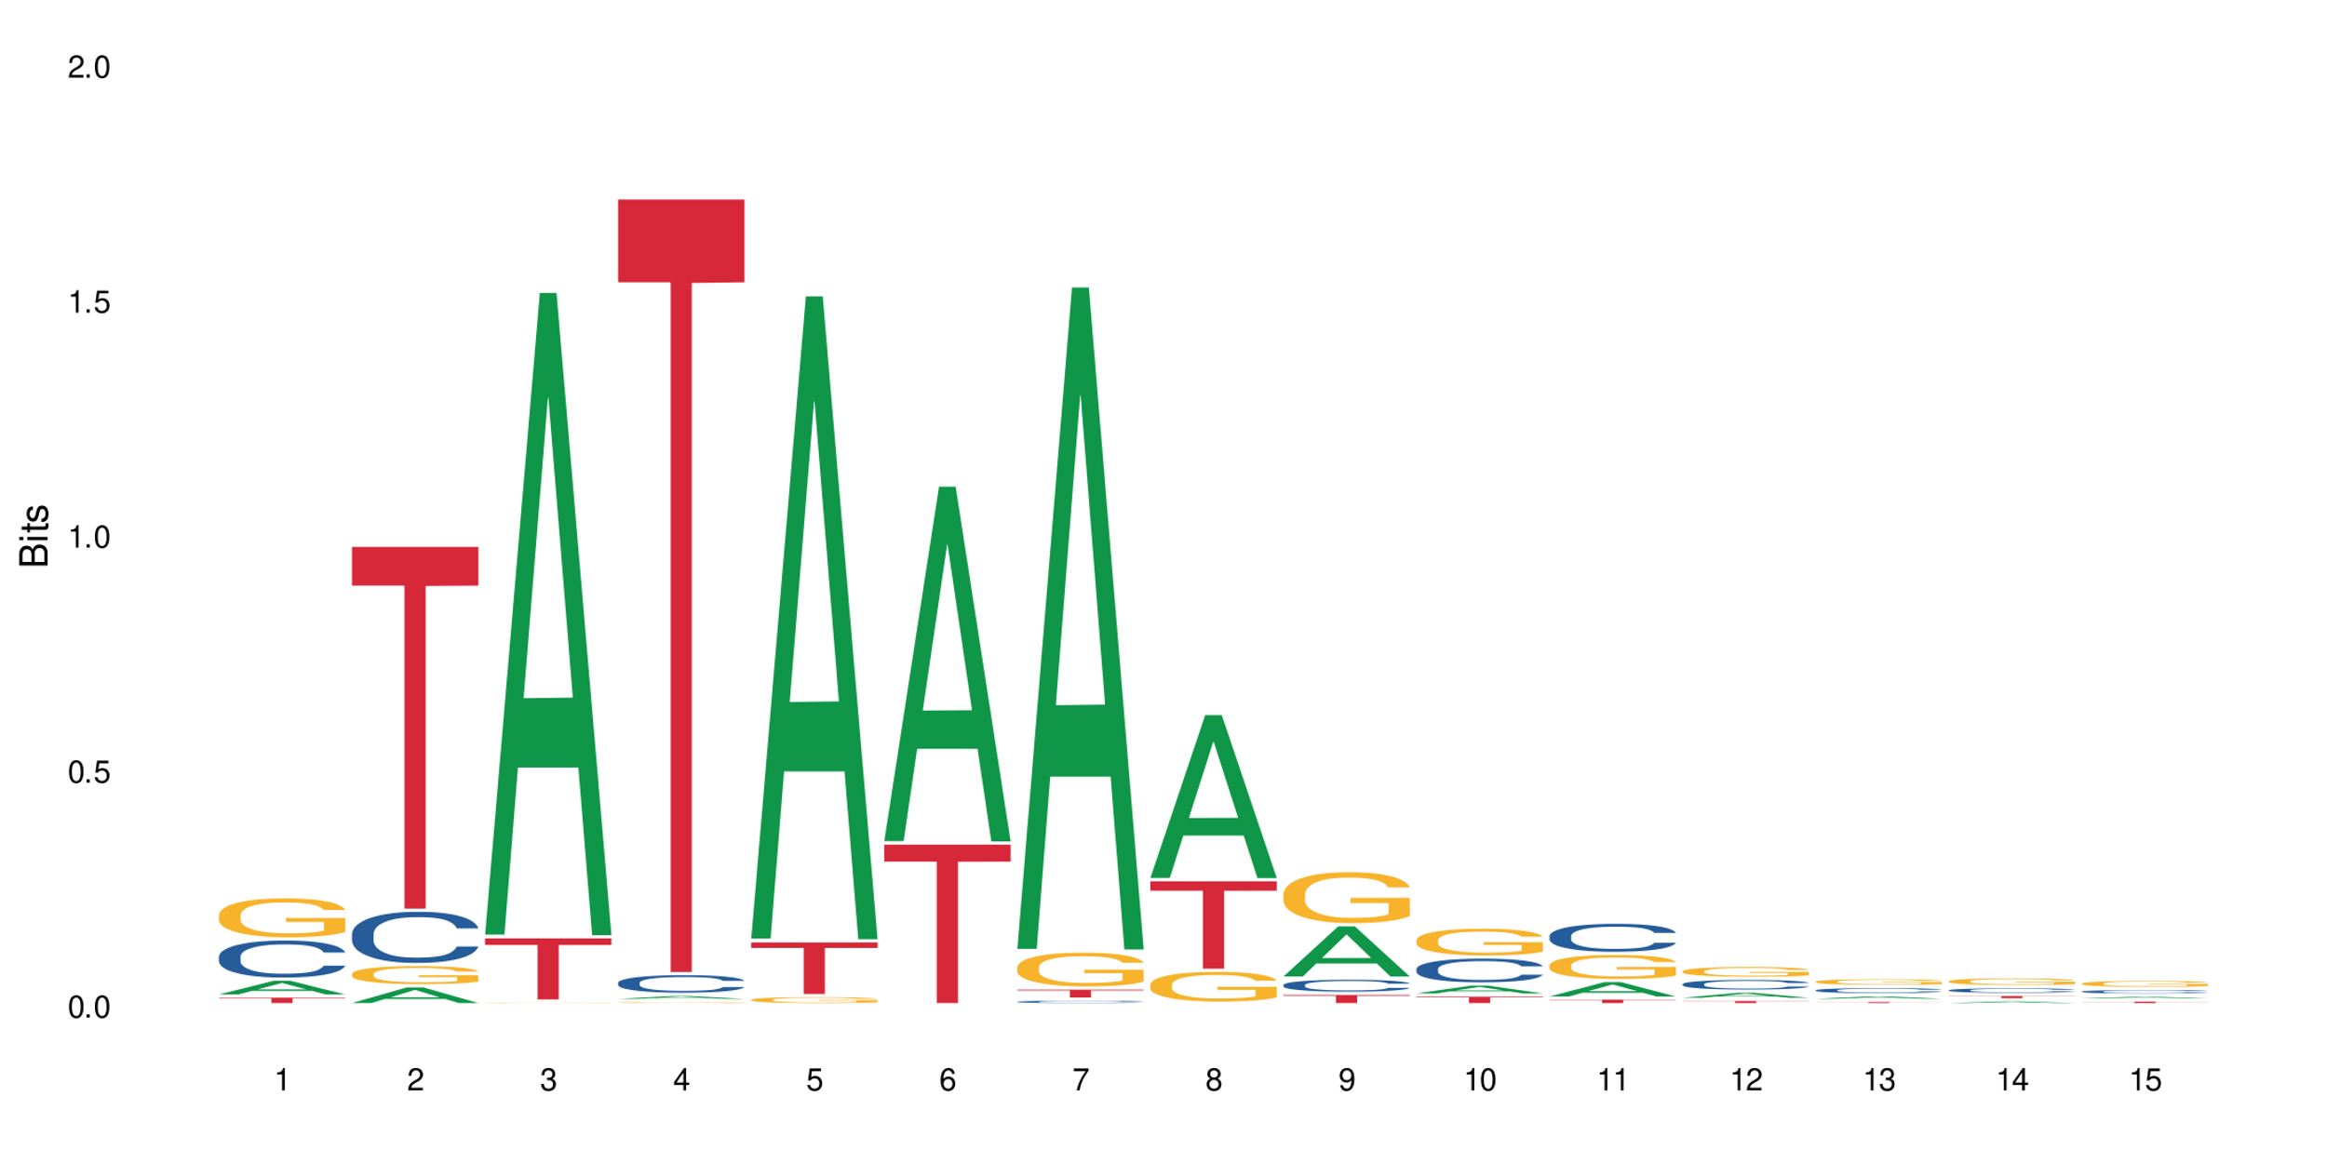
TBP
TBP = TATA binding protein
The TFIID basal transcription factor complex plays a major role in the initiation of RNA polymerase II (Pol II)-dependent transcription. TFIID recognizes and binds promoters with or without a TATA box via its subunit TBP, a TATA-box-binding protein, and promotes assembly of the pre-initiation
complex (PIC). The TFIID complex consists of TBP and TBP-associated factors (TAFs), including TAF1, TAF2, TAF3, TAF4, TAF5, TAF6, TAF7, TAF8, TAF9, TAF10, TAF11, TAF12
and TAF13 The TFIID complex structure can be divided into 3 modules TFIID-A, TFIID-B, and TFIID-C and TBP forms the TFIID-A module with TAF3 and TAF5.
TBP specifically recognizes the TATA box sequence 5'-TATAAA-3’ and binds to the minor groove of DNA rather than the major groove, which is more common for other transcription factors.
Gives the promoter a topology that favours the binding of other transcription factors, thus allowing transcription to begin.

Slide 3
Quality controls
Replicate 1 | Replicate 2 | Control/Input
18.933.377 (68,04%) | 16.489.353 (66,59%) | 13.997.274 (72,62%)
6.069.799 (21,81%) | 5.954.515 (24,10%) | 3.179.868 (16,50%)
2.824.956 (10,15%) | 2.302.947 (9,31%) | 2.097.438 (10,88%)
27.828.132 (100%) | 24.746.815 (100%) | 19.274.580 (100%)
Uniquely mapping reads
Multimapping reads
Non mapping reads
Total reads

Slide 4
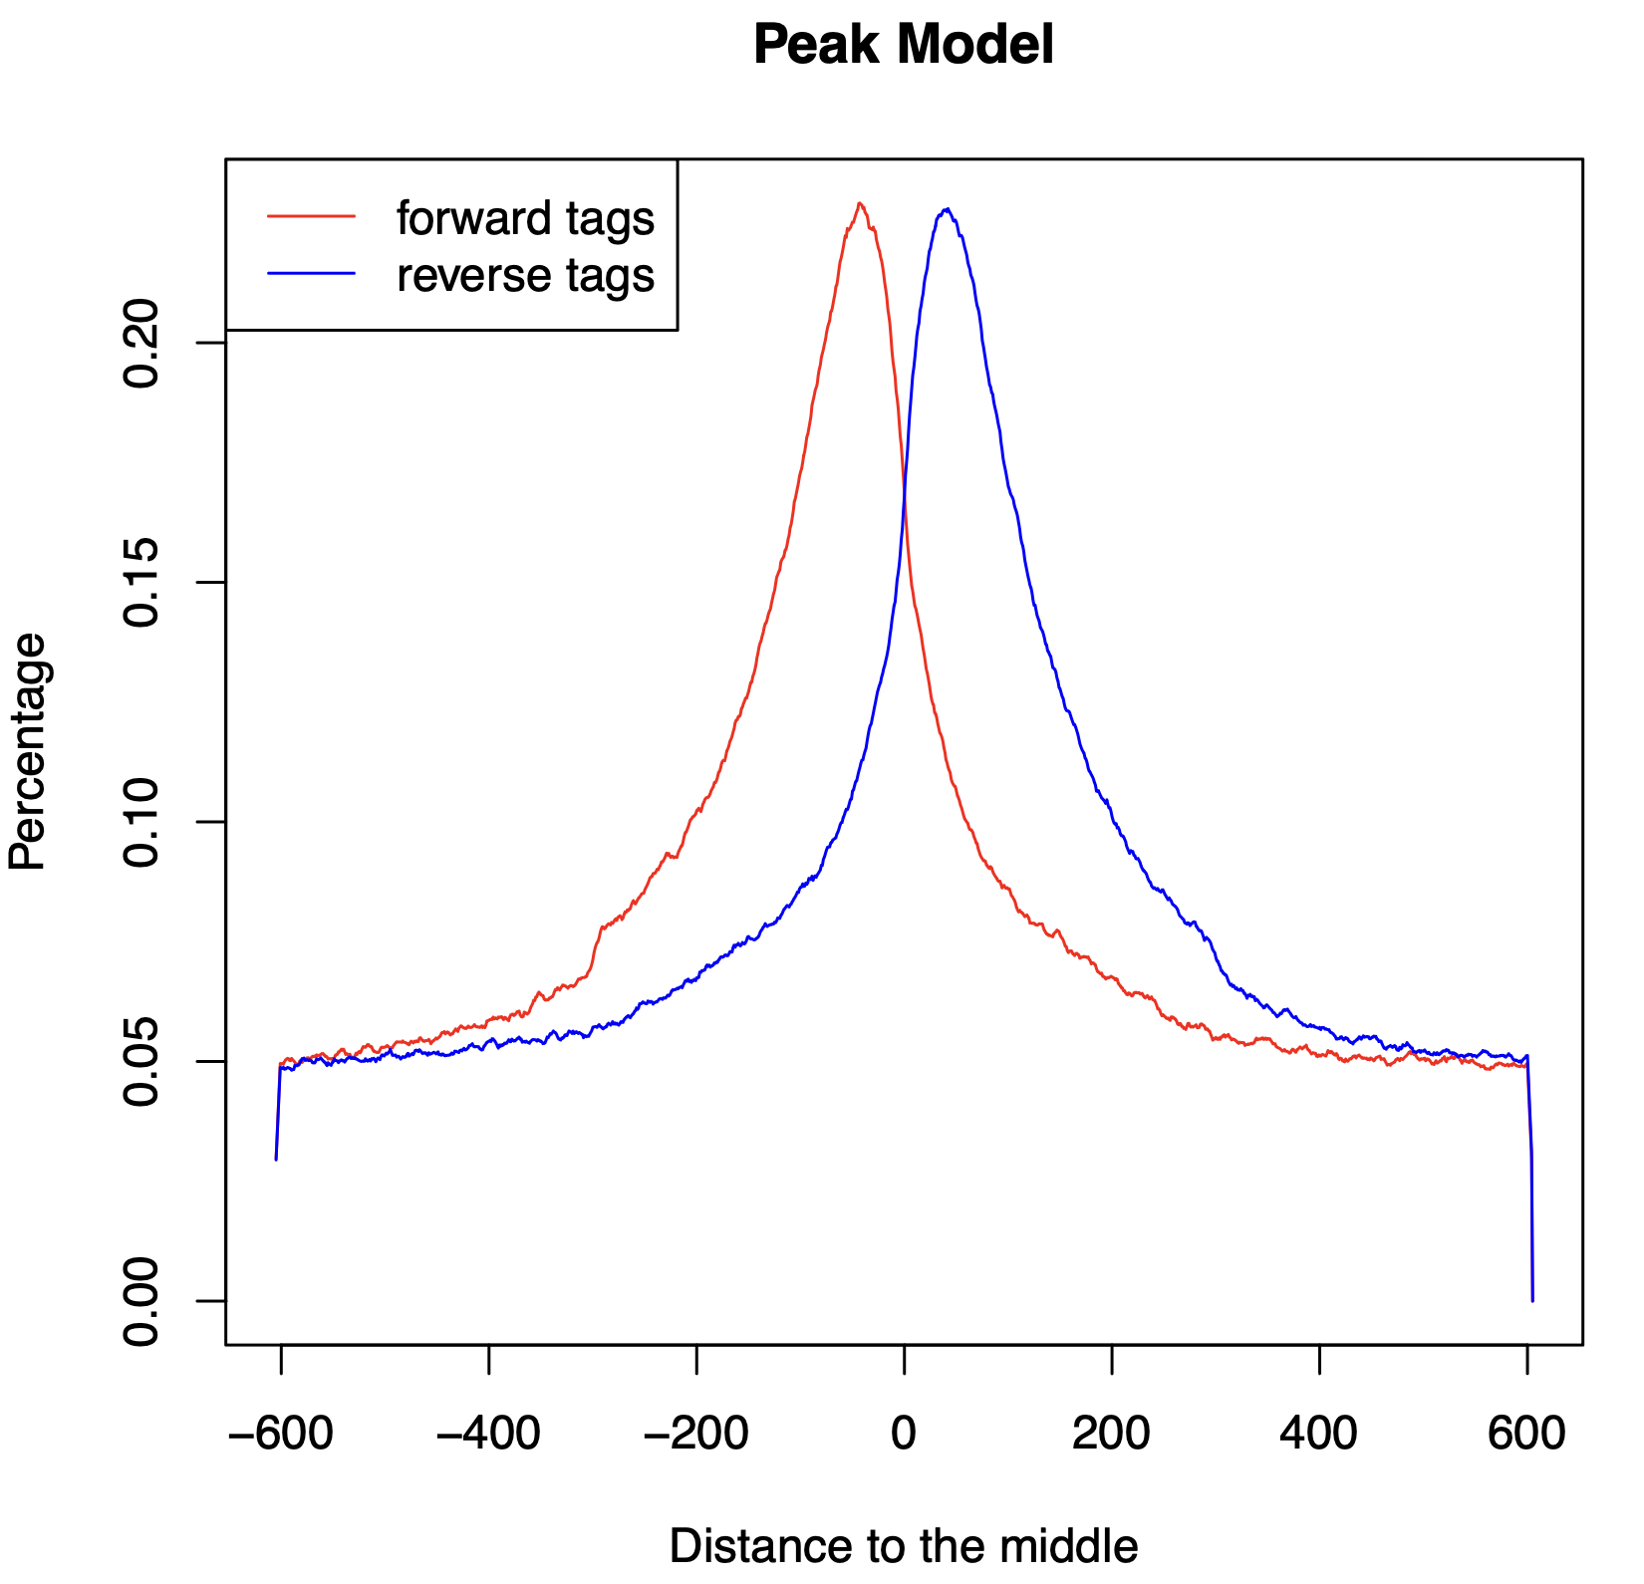
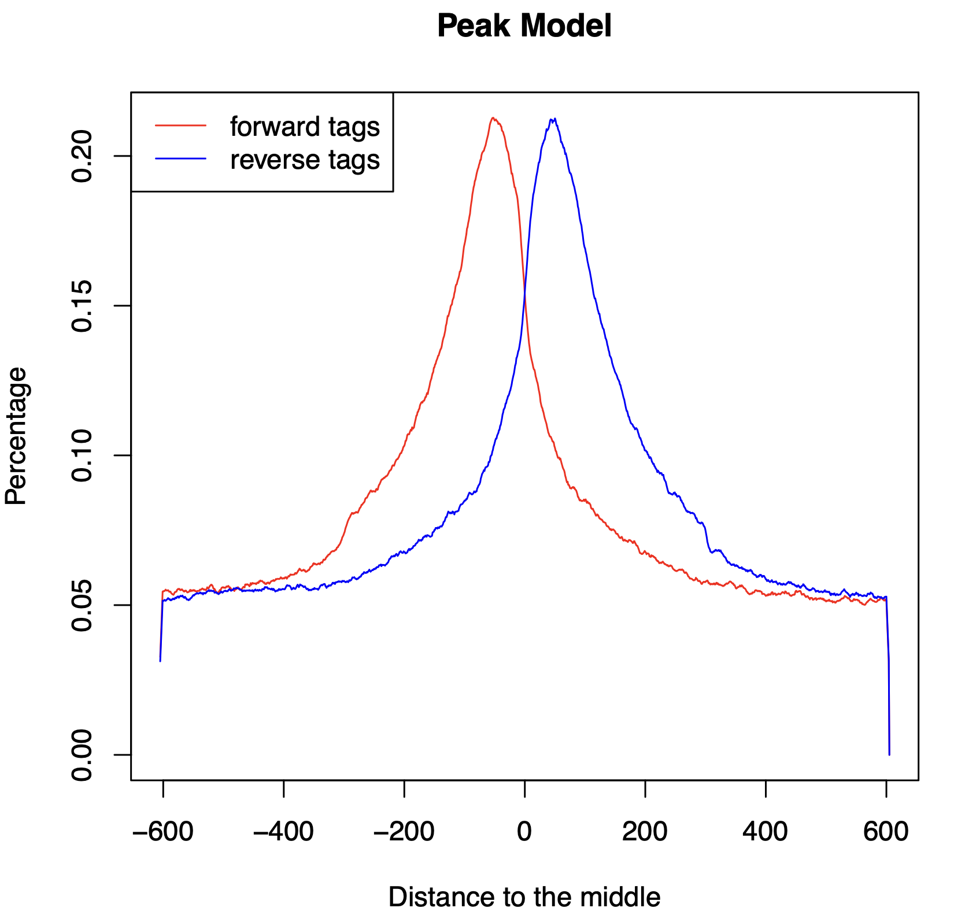
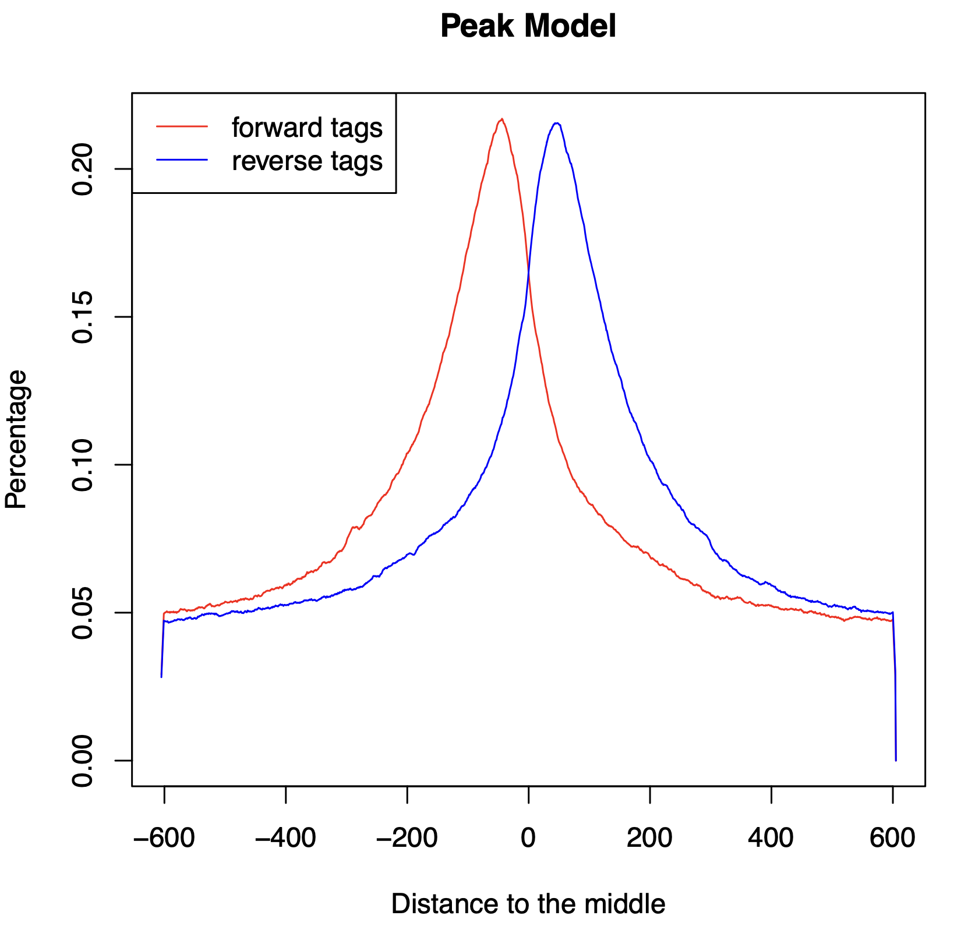
Peak calling
Replicate 1 | Replicate 2 | Merged
21.327 | 33.423 | 23.789
0,11 | 0,12 | 0,13
103 | 113 | 106
4 | 7 | 3
Number of peaks
Redundant rate
Fragment size estimated
Removed ”blacklisted” region

Slide 5
Common peaks
Intersection 1-2 | Intersection 2-1 | Intersection 1-M | Intersection 2-M | Summit proximity
20.191 | 18.509 | 20.332 | 22.300 | 16.858
Number of overlap

Slide 6
Comparison with ENCODE
Simple region overlap
with ENCODE
Rep.1 | Rep.2 | Rep.1-Rep.2 | Rep.2-Rep.1 | Merged
15066 | 17436 | 14812 | 14171 | 15984
0,363 | 0,365 | 0,370 | 0,380 | 0,385
Number of peak
Jaccard index

Slide 7
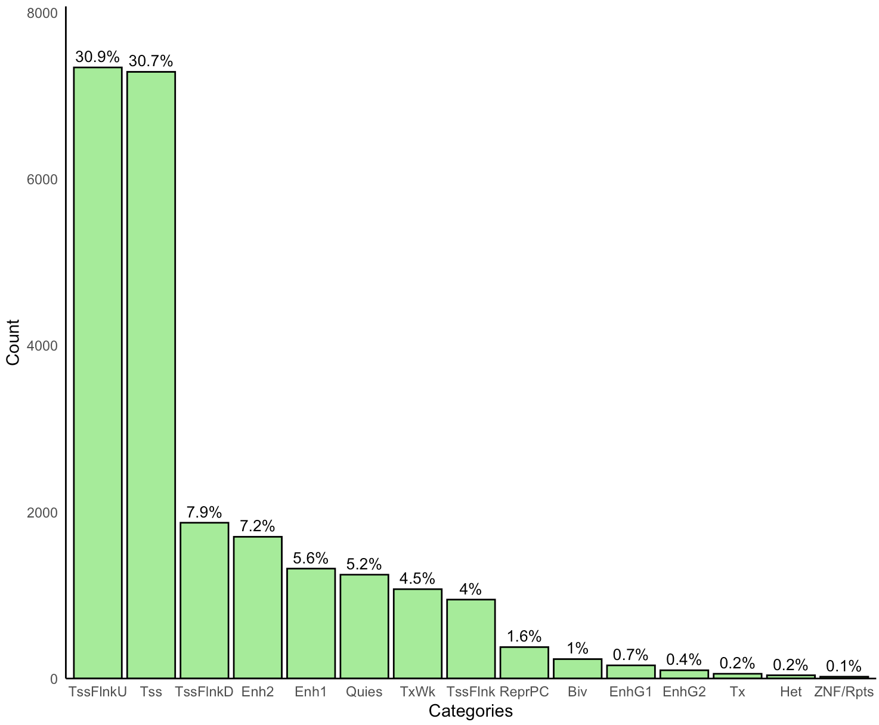
Chromatin states
H3K4me1, H3K4me2, H3K4me3,
H3K9ac, H3K27ac

Slide 8
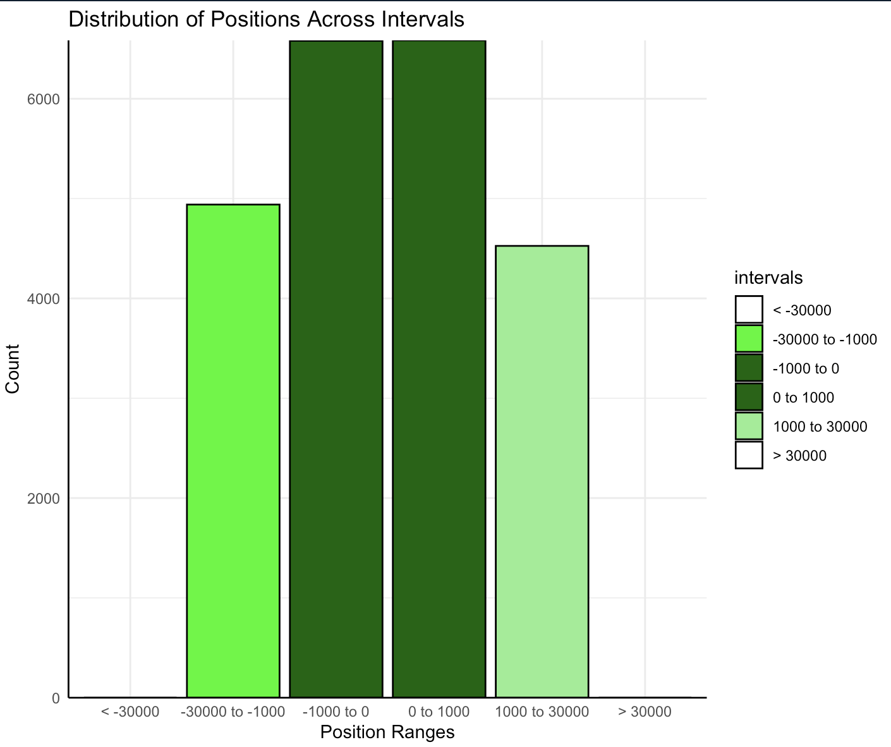
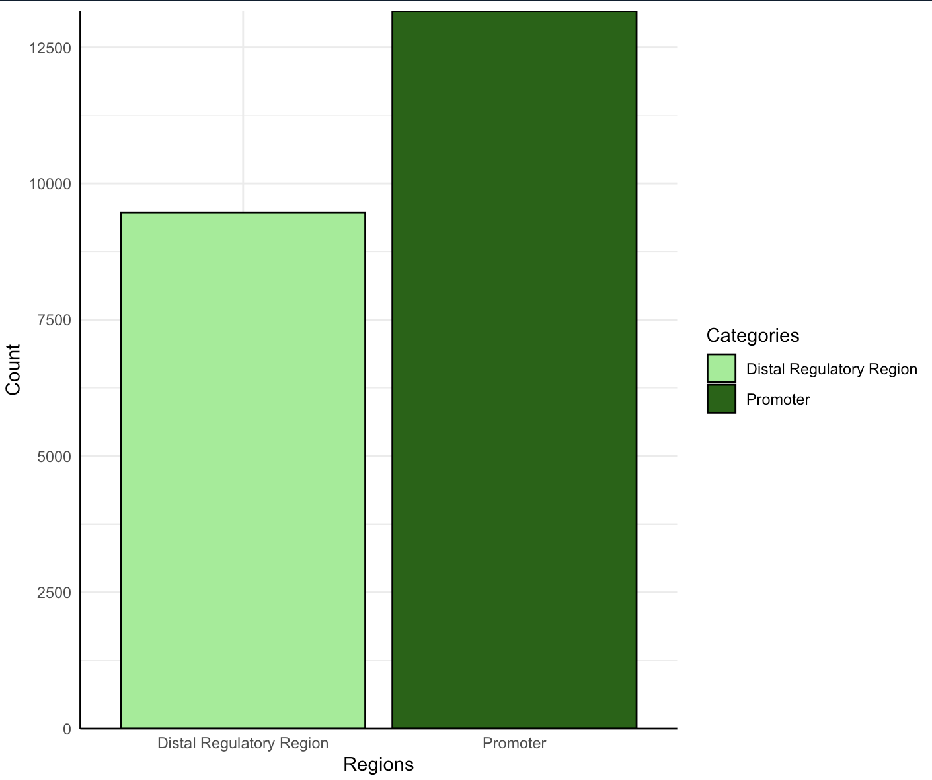
Target genes
Thanks to GREAT, I 11.432 genes target found

Slide 9
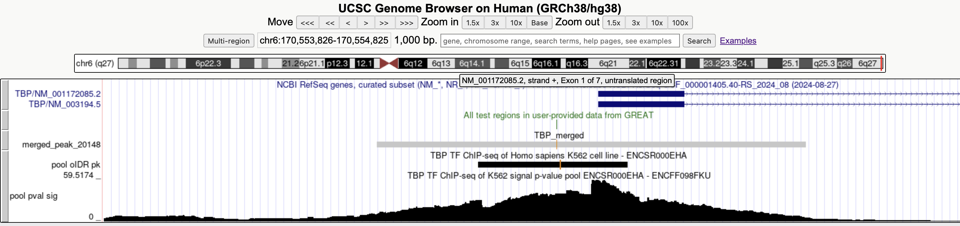
GREAT peak
Thanks to GREAT I see that:
- TBP is self-regulating

Slide 10
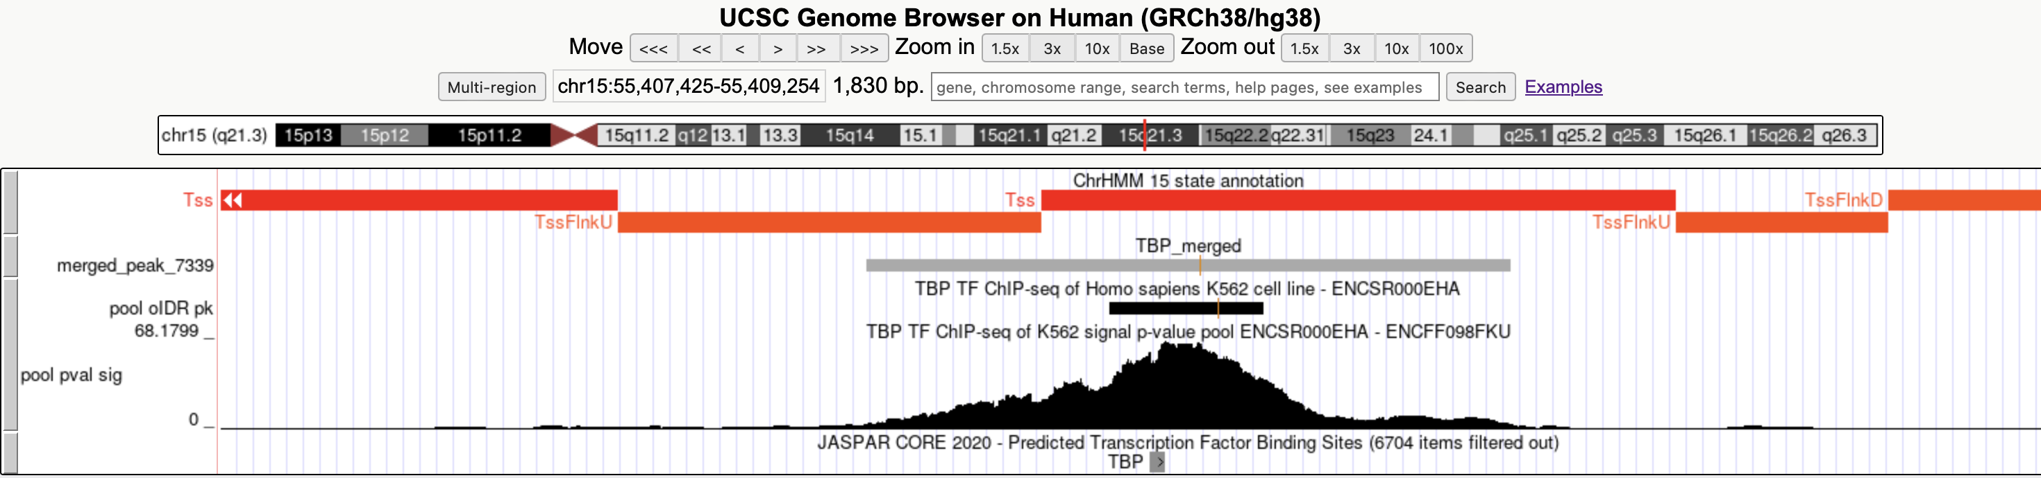
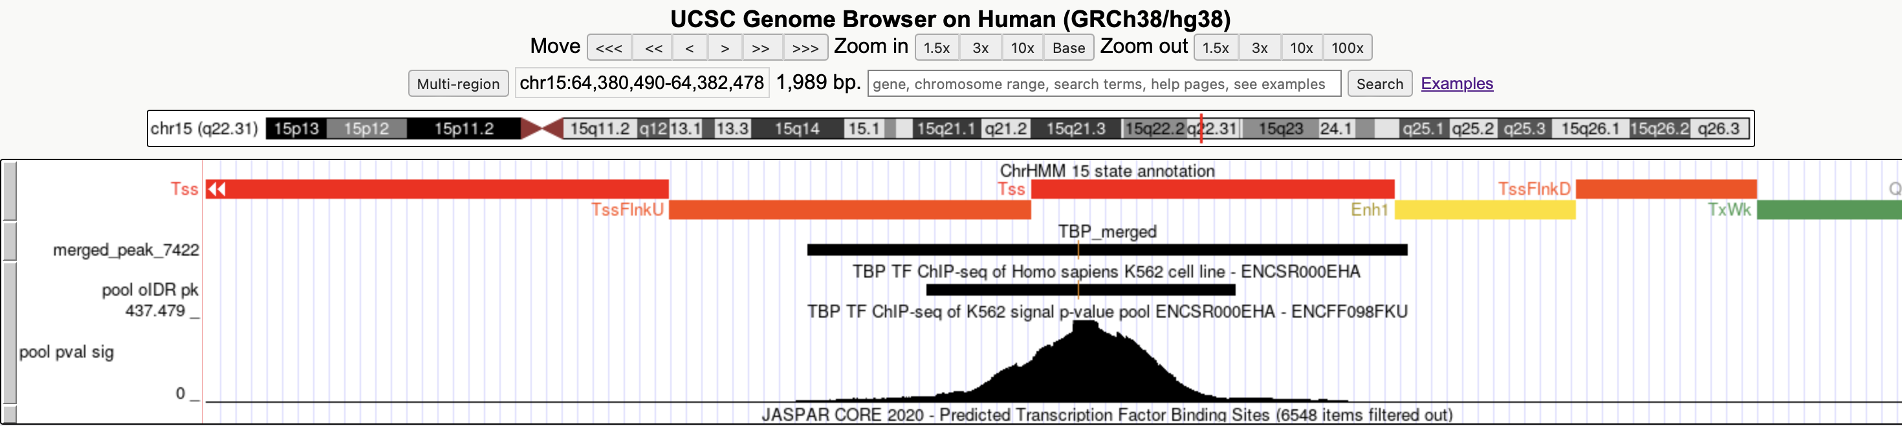
Visualization

Slide 11
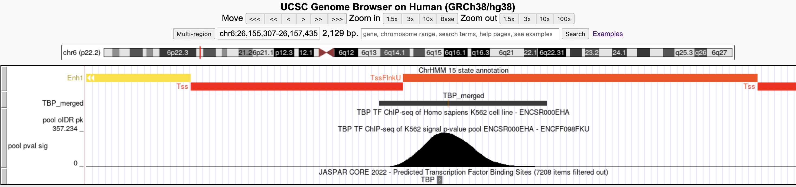
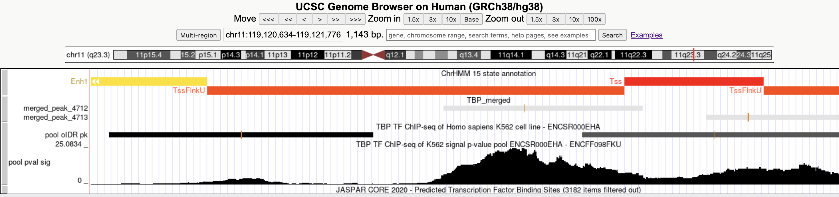
Visualization

Slide 12
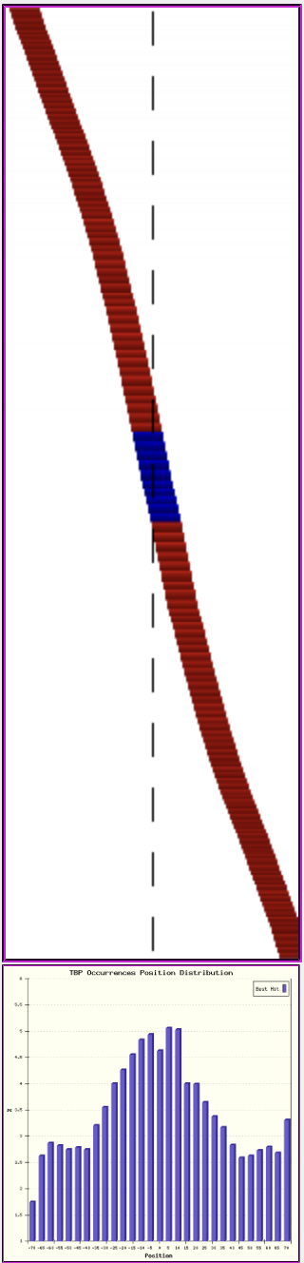
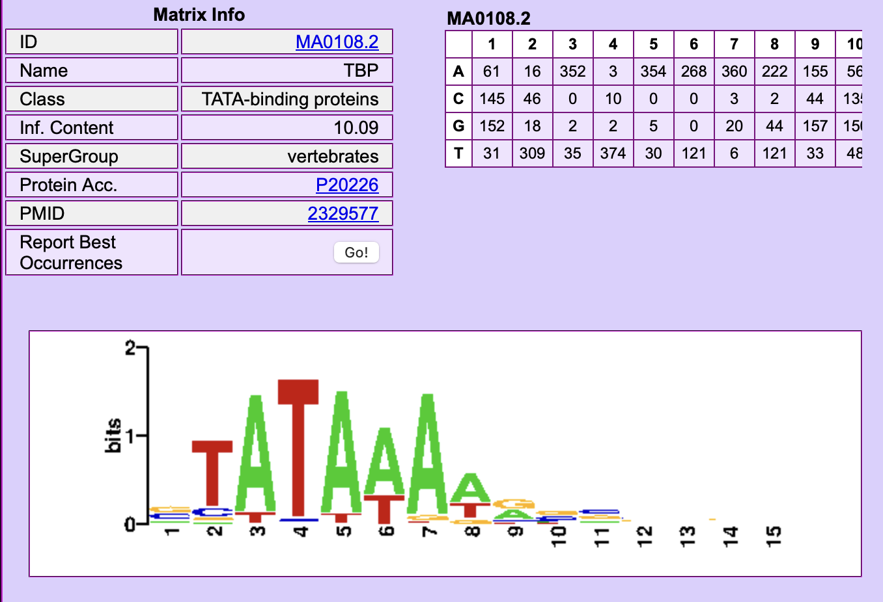
Motif analysis
NAME
ID
L.PV
L.O/U
G.PV
G.O/U
SP.COR
P.POS
P.POS.PV

Slide 13
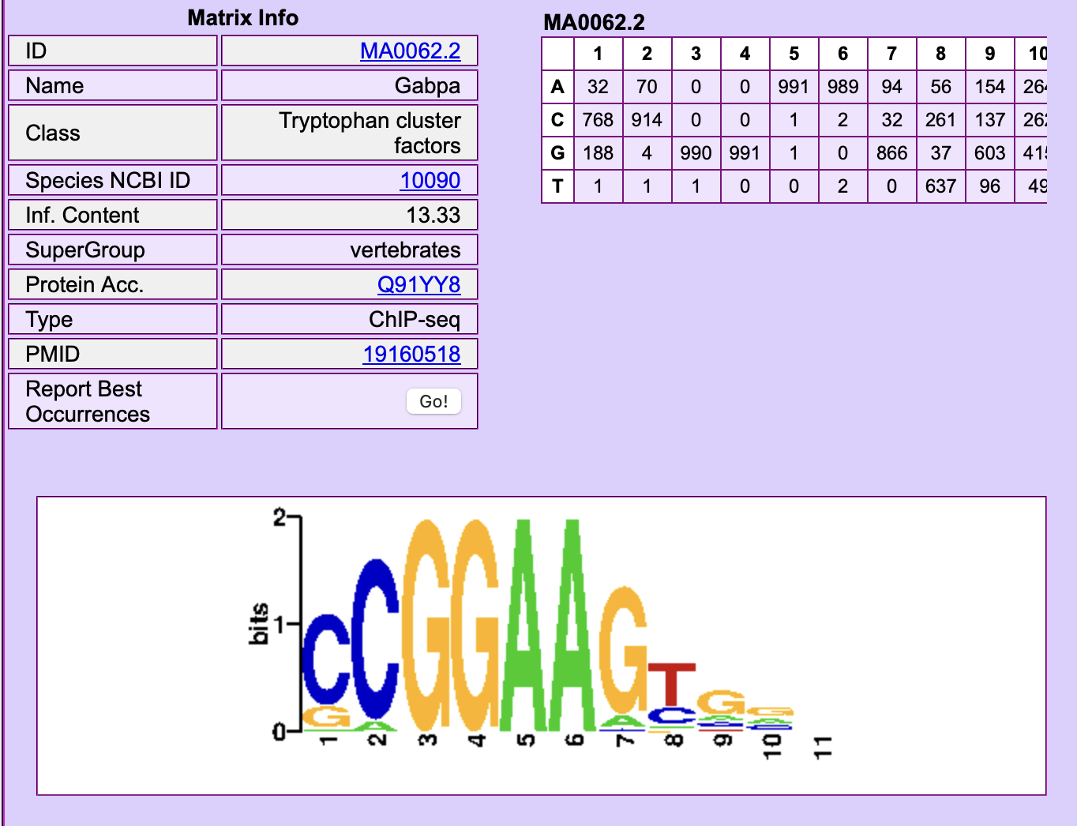
Motif analysis
Gabpa = GA binding protein transcription factor subunit alpha
It’s one of three main subunits that are involved in activation of cytochrome oxidase expression and nuclear control of mitochondrial function.
This subunit also shares identity with a subunit constituting the transcription factor E4TF1, responsible for expression of the adenovirus E4 gene.
Because of its chromosomal localization and ability to form heterodimers with other polypeptides, this gene may play a role in the Down
Syndrome phenotype.
Why did I find this gene more enriched?
This is only one example, but the are many other genes
before TBP. The explanation is that Gabpa, like other proteins,
recruits TBP and other proteins, that forms the transcription complex
allowing to start the transcription process for the target genes.

